Slide 1
Cloud Network Security
With AWS Day 2

Slide 2
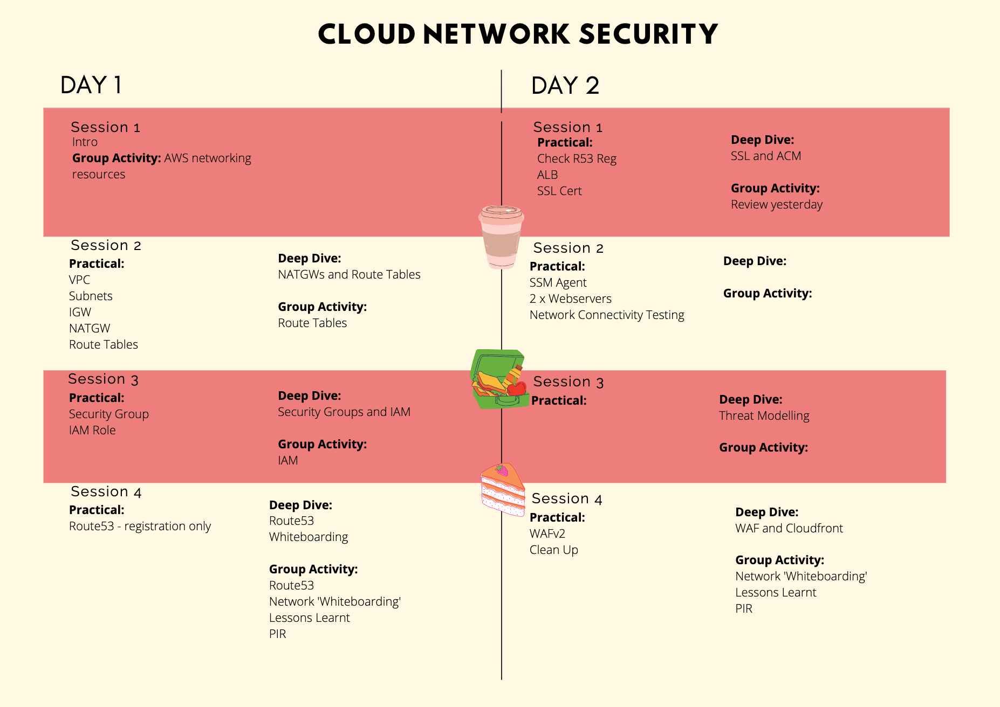
Our Agenda for the 2 days

Slide 3
What have we done so far?
Notes:
Activity:
Using your whiteboarding skills, in groups of 3, spend 10minutes drawing up the network diagrams from yesterday as a review.
White down any questions you still have from yesterday and lets answer as a group after the 10mins.

Slide 4
Let’s encrypt!
Notes:
Github Repo for steps on setting up a TLS cert for our load balancer using AWS Cert manager

